Slide 1
Finding Edges and Straight Lines
02/10/11
Computer Vision
CS 543 / ECE 549
University of Illinois
Derek Hoiem
Many slides from Lana Lazebnik, Steve Seitz, David Forsyth, David Lowe, Fei-Fei Li

Slide 2
Edge detection
Goal: Identify sudden changes (discontinuities) in an image
Intuitively, most semantic and shape information from the image can be encoded in the edges
More compact than pixels
Ideal: artist’s line drawing (but artist is also using object-level knowledge)
Source: D. Lowe

Slide 3
Last class
How to use filters for
Matching
Denoising
Compression
Image representation with pyramids
Texture and filter banks

Slide 4
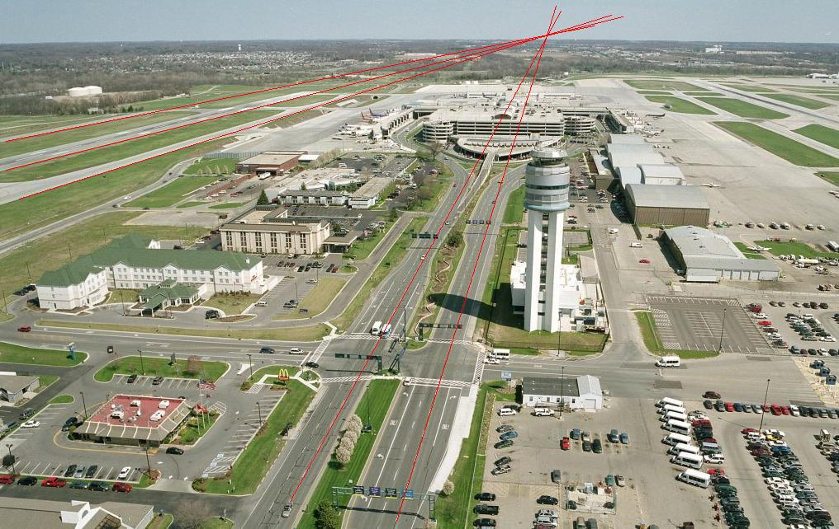
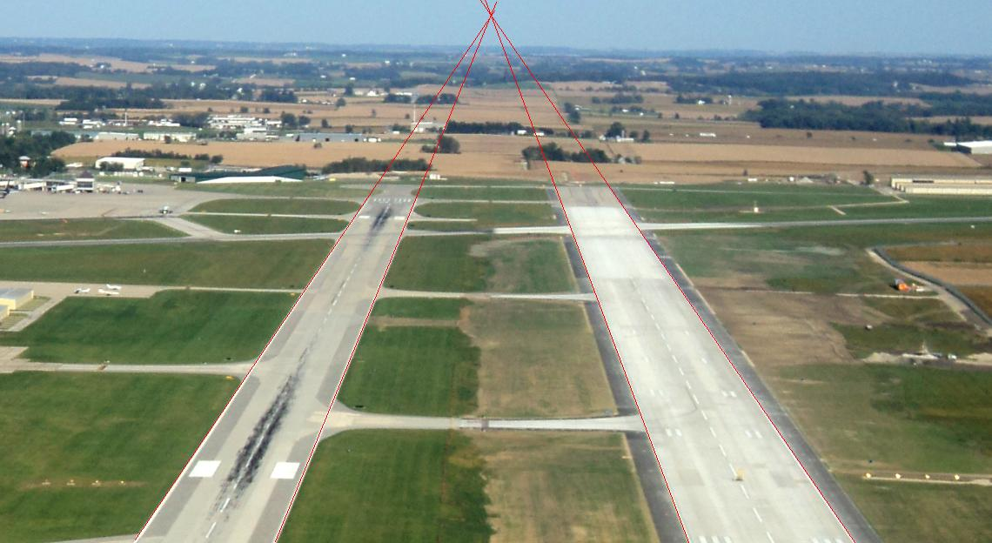
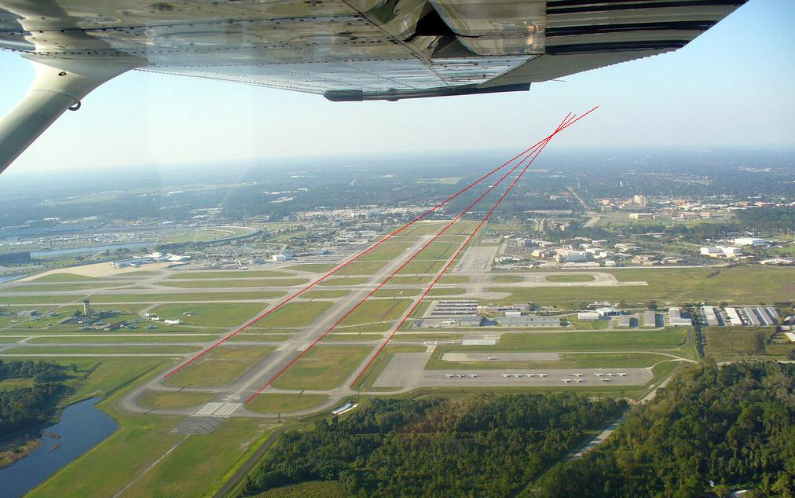
A couple remaining questions from earlier
Does the curvature of the earth change the horizon location?
Illustrations from Amin Sadeghi

Slide 5
A couple remaining questions from earlier
Computational complexity of coarse-to-fine search?
Image 1 Pyramid
Image 2 Pyramid
Size M
Size N
Repeated Local Neighborhood Search O(M)
Downsampling: O(N+M)
Low Resolution Search O(N/M)
Overall complexity: O(N+M)
Original high-resolution full search: O(NM) or O(N logN)

Slide 6
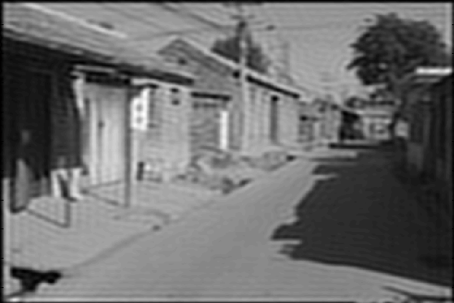
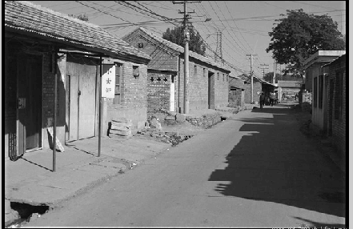
A couple remaining questions from earlier
Why not use an ideal filter?
Answer: has infinite spatial extent, clipping results in ringing
Attempt to apply ideal filter in frequency domain

Slide 7
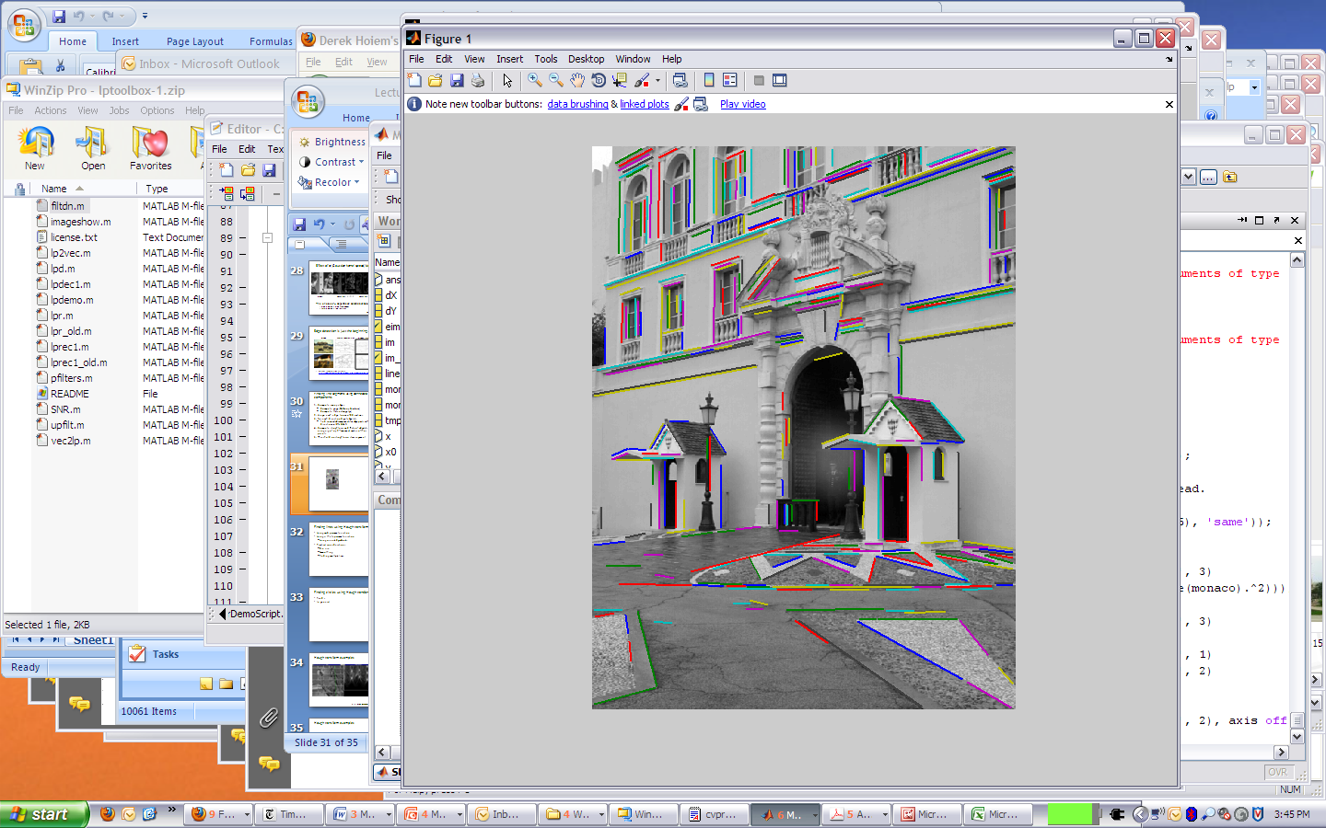
Today’s class
Detecting edges
Finding straight lines

Slide 8
Why do we care about edges?
Extract information, recognize objects
Recover geometry and viewpoint
Vertical vanishing
point
(at infinity)
Vanishing
line
Vanishing
point
Vanishing
point

Slide 9
Origin of Edges
surface normal discontinuity
depth discontinuity
surface color discontinuity
illumination discontinuity
Edges are caused by a variety of factors
Source: Steve Seitz

Slide 10
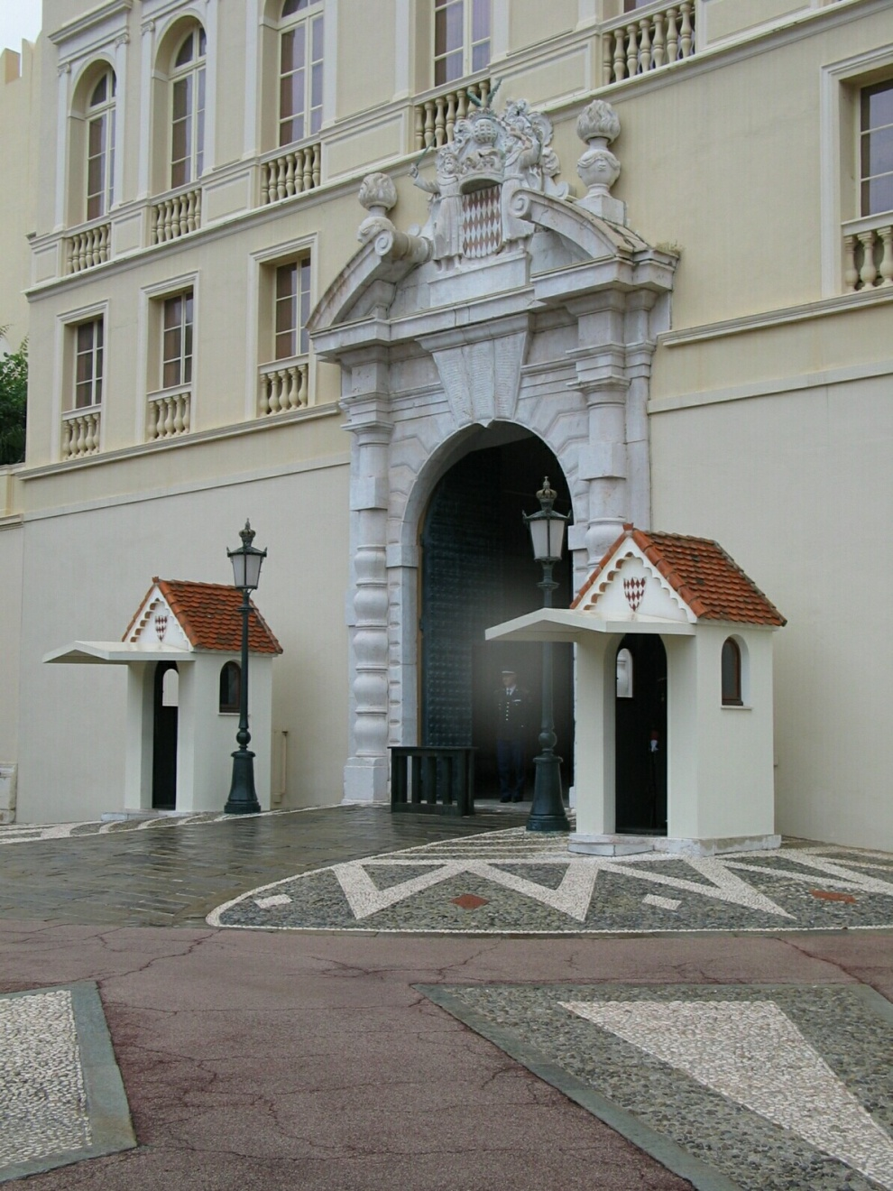
Closeup of edges

Slide 11
Closeup of edges

Slide 12
Closeup of edges

Slide 13
Closeup of edges

Slide 14

Characterizing edges
An edge is a place of rapid change in the image intensity function
intensity function (along horizontal scanline)
image
first derivative
edges correspond to extrema of derivative

Slide 15
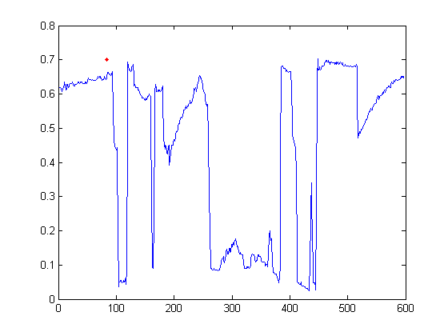

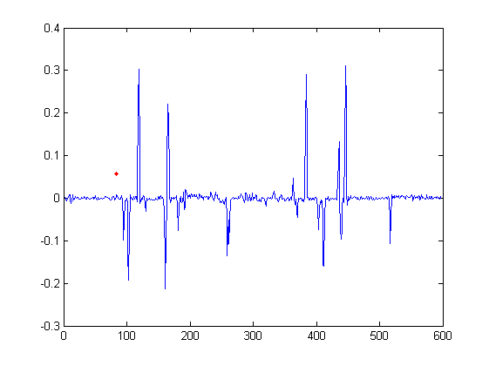
Intensity profile

Slide 16
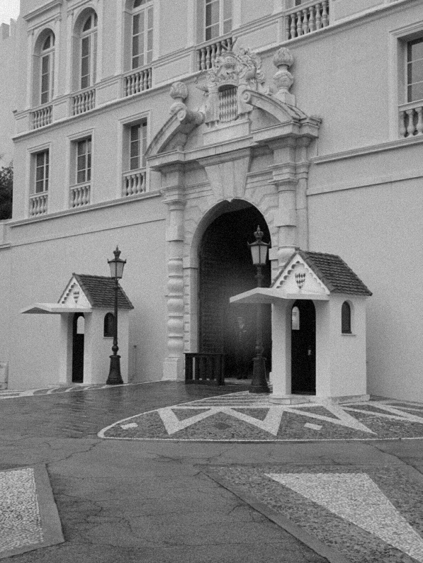
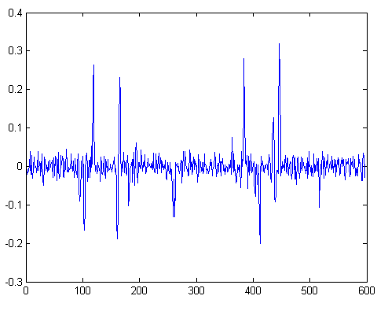
With a little Gaussian noise
Gradient

Slide 17
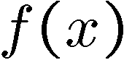
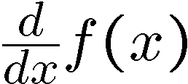
Effects of noise
Consider a single row or column of the image
Plotting intensity as a function of position gives a signal
Where is the edge?
Source: S. Seitz
Notes:
How to fix?

Slide 18
Effects of noise
Difference filters respond strongly to noise
Image noise results in pixels that look very different from their neighbors
Generally, the larger the noise the stronger the response
What can we do about it?
Source: D. Forsyth

Slide 19
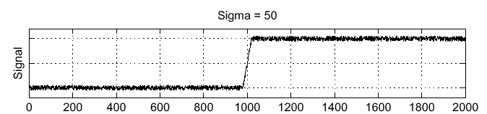
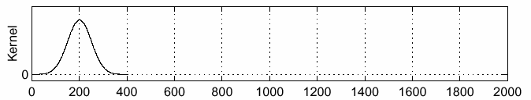
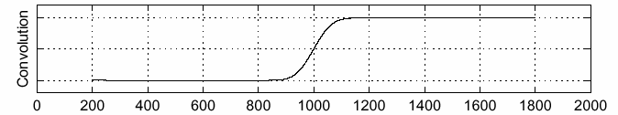
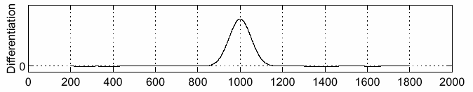
Solution: smooth first
f
g
f * g
To find edges, look for peaks in
Source: S. Seitz

Slide 20
Derivative theorem of convolution
Differentiation is convolution, and convolution is associative:
This saves us one operation:
f
Source: S. Seitz

Slide 21
Derivative of Gaussian filter
* [1 -1] =
Is this filter separable?

Slide 22
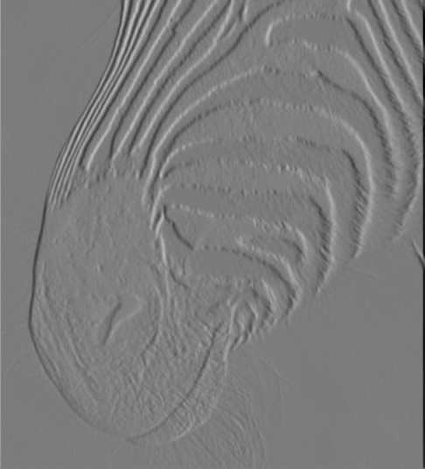
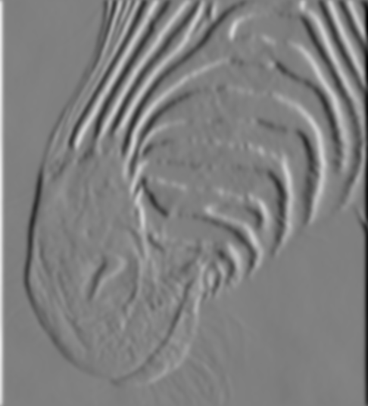
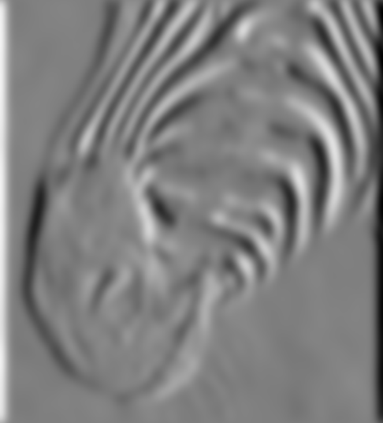
Tradeoff between smoothing and localization
1 pixel
3 pixels
7 pixels
Smoothed derivative removes noise, but blurs edge. Also finds edges at different “scales”.
Source: D. Forsyth

Slide 23
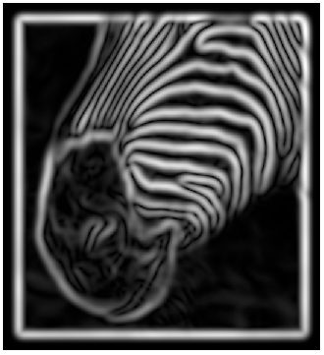
Implementation issues
The gradient magnitude is large along a thick “trail” or “ridge,” so how do we identify the actual edge points?
How do we link the edge points to form curves?
Source: D. Forsyth
Notes:
Figures show gradient magnitude of zebra at two different scales

Slide 24
Designing an edge detector
Criteria for a good edge detector:
Good detection: the optimal detector should find all real edges, ignoring noise or other artifacts
Good localization
the edges detected must be as close as possible to the true edges
the detector must return one point only for each true edge point
Cues of edge detection
Differences in color, intensity, or texture across the boundary
Continuity and closure
High-level knowledge
Source: L. Fei-Fei

Slide 25
Canny edge detector
This is probably the most widely used edge detector in computer vision
Theoretical model: step-edges corrupted by additive Gaussian noise
Canny has shown that the first derivative of the Gaussian closely approximates the operator that optimizes the product of signal-to-noise ratio and localization
J. Canny, A Computational Approach To Edge Detection, IEEE Trans. Pattern Analysis and Machine Intelligence, 8:679-714, 1986.
Source: L. Fei-Fei

Slide 26
Note about Matlab’s Canny detector
Small errors in implementation
Gaussian function not properly normalized
First filters with a Gaussian, then a difference of Gaussian (equivalent to filtering with a larger Gaussian and taking difference)

Slide 27

Example
original image (Lena)

Slide 28
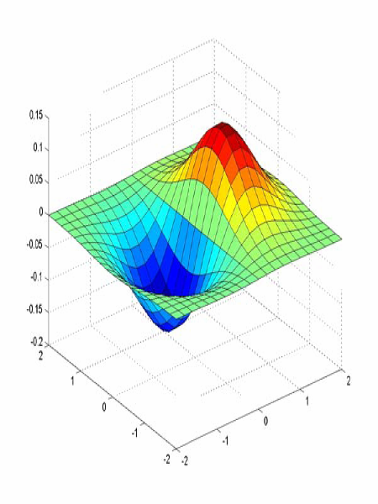
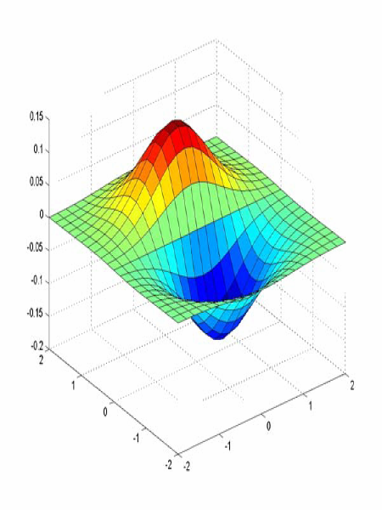
Derivative of Gaussian filter
x-direction
y-direction

Slide 29
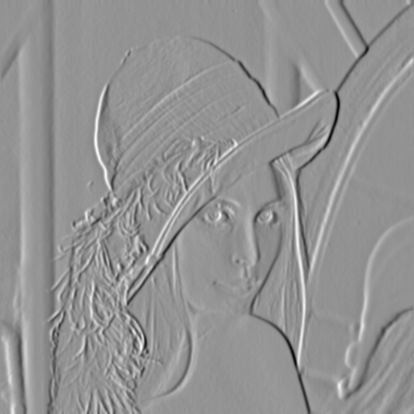
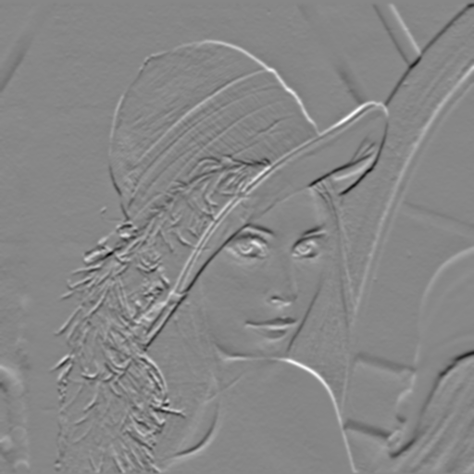
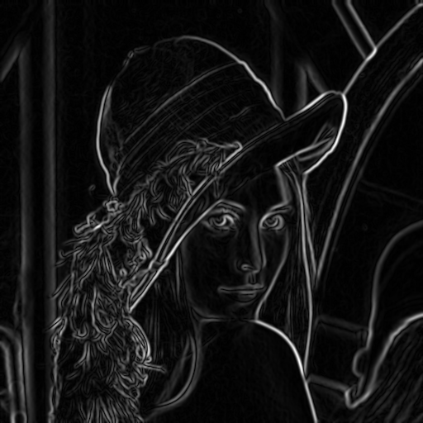
Compute Gradients (DoG)
X-Derivative of Gaussian
Y-Derivative of Gaussian
Gradient Magnitude

Slide 30
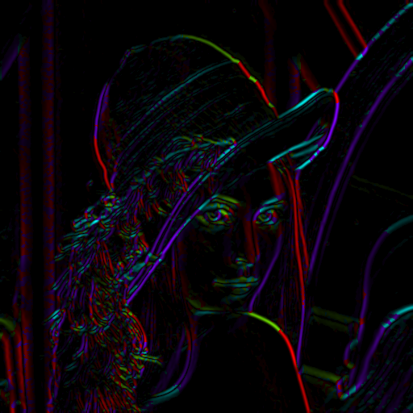
Get Orientation at Each Pixel
Threshold at minimum level
Get orientation
theta = atan2(gy, gx)

Slide 31


Non-maximum suppression for each orientation
At q, we have a maximum if the value is larger than those at both p and at r. Interpolate to get these values.
Source: D. Forsyth

Slide 32
Edge linking
Assume the marked point is an edge point. Then we construct the tangent to the edge curve (which is normal to the gradient at that point) and use this to predict the next points (here either r or s).
Source: D. Forsyth

Slide 33
Before Non-max Suppression

Slide 34
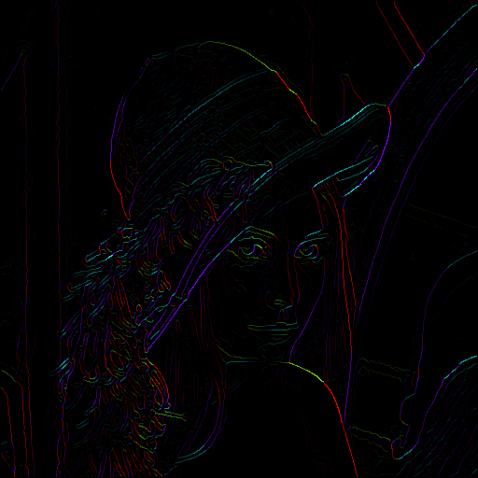
After non-max suppression

Slide 35
Before Non-max Suppression

Slide 36
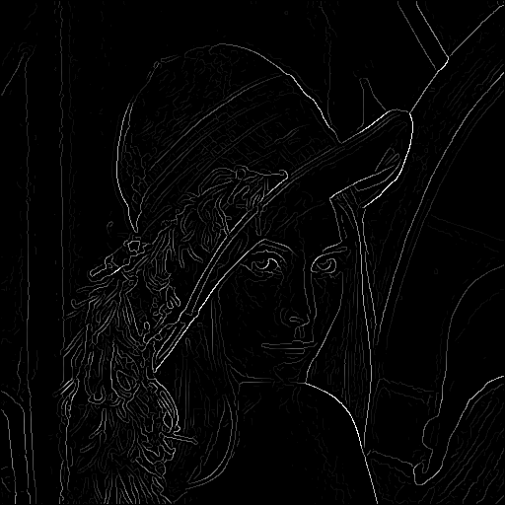
After non-max suppression

Slide 37
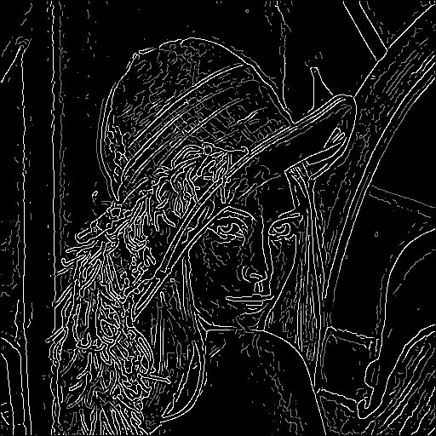
Hysteresis thresholding
Threshold at low/high levels to get weak/strong edge pixels
Do connected components, starting from strong edge pixels

Slide 38
Hysteresis thresholding
Check that maximum value of gradient value is sufficiently large
drop-outs? use hysteresis
use a high threshold to start edge curves and a low threshold to continue them.
Source: S. Seitz

Slide 39
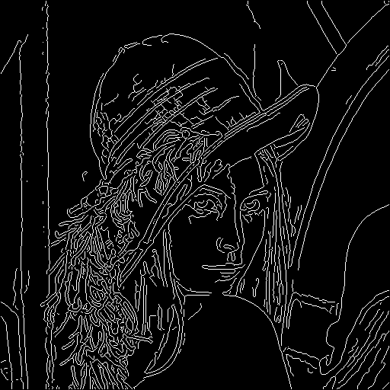
Final Canny Edges

Slide 40
Canny edge detector
Filter image with x, y derivatives of Gaussian
Find magnitude and orientation of gradient
Non-maximum suppression:
Thin multi-pixel wide “ridges” down to single pixel width
Thresholding and linking (hysteresis):
Define two thresholds: low and high
Use the high threshold to start edge curves and the low threshold to continue them
MATLAB: edge(image, ‘canny’)
Source: D. Lowe, L. Fei-Fei

Slide 41
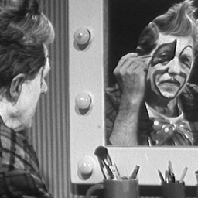
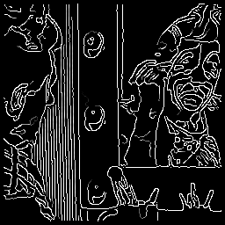
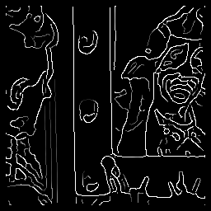
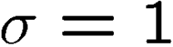
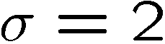
Effect of σ (Gaussian kernel spread/size)
original
Canny with
Canny with
The choice of σ depends on desired behavior
large σ detects large scale edges
small σ detects fine features
Source: S. Seitz

Slide 42
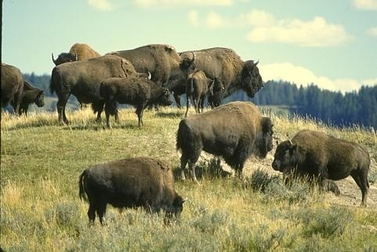
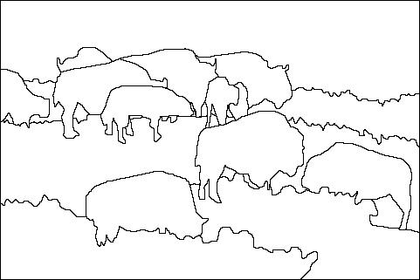
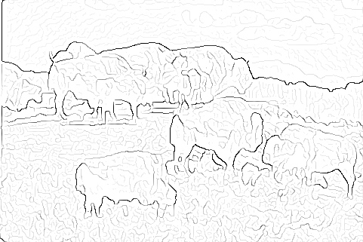

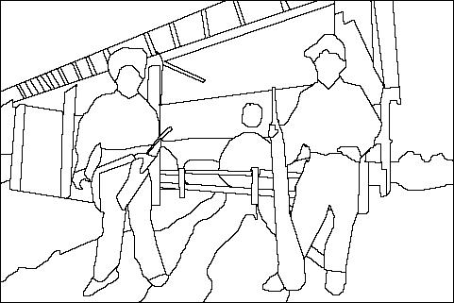
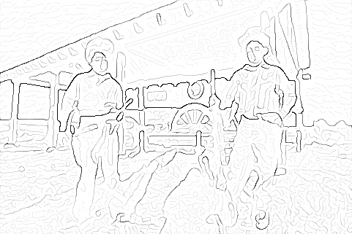
Learning to detect boundaries
image
human segmentation
gradient magnitude
Berkeley segmentation database: http://www.eecs.berkeley.edu/Research/Projects/CS/vision/grouping/segbench/

Slide 43
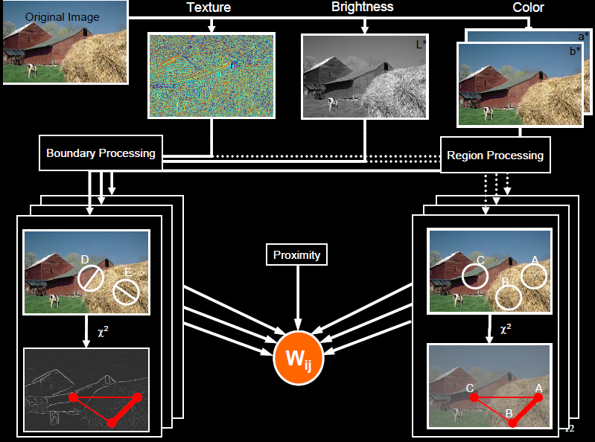
pB boundary detector
Martin, Fowlkes, Malik 2004: Learning to Detection Natural Boundaries…
http://www.eecs.berkeley.edu/Research/Projects/CS/vision/grouping/papers/mfm-pami-boundary.pdf
Figure from Fowlkes

Slide 44
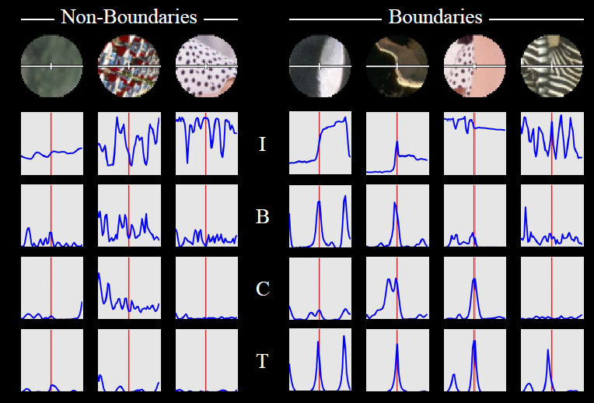
pB Boundary Detector
Figure from Fowlkes

Slide 45
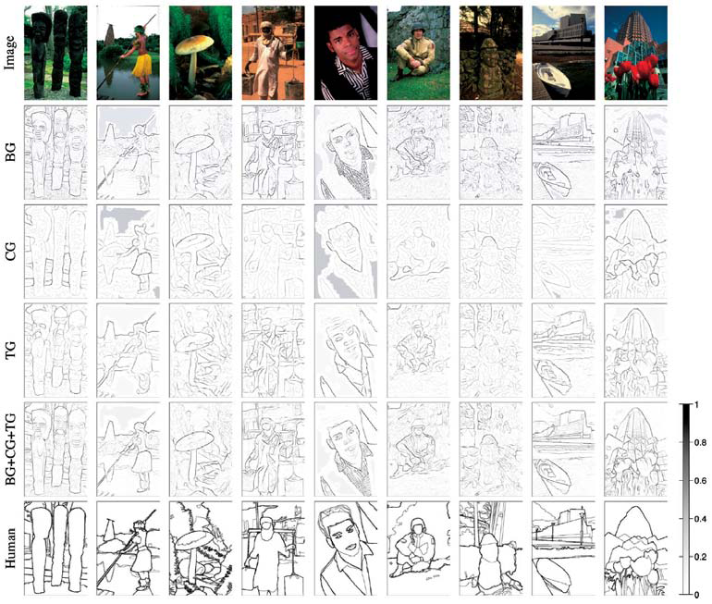
Brightness
Color
Texture
Combined
Human

Slide 46
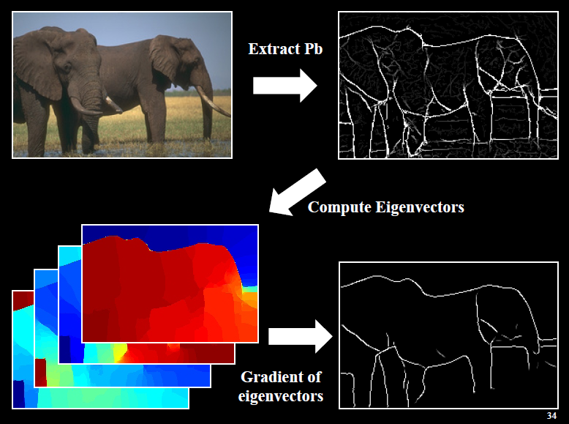
Global pB boundary detector
Figure from Fowlkes

Slide 47
Finding straight lines
One solution: try many possible lines and see how many points each line passes through
Hough transform provides a fast way to do this

Slide 48
Outline of Hough Transform
Create a grid of parameter values
Each point votes for a set of parameters, incrementing those values in grid
Find maximum or local maxima in grid

Slide 49
Finding lines using Hough transform
Using m,b parameterization
Using r, theta parameterization
Using oriented gradients
Practical considerations
Bin size
Smoothing
Finding multiple lines
Finding line segments

Slide 50
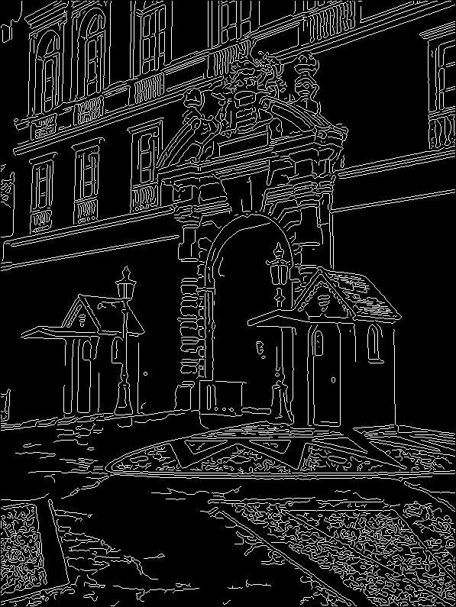
1. Image → Canny

Slide 51
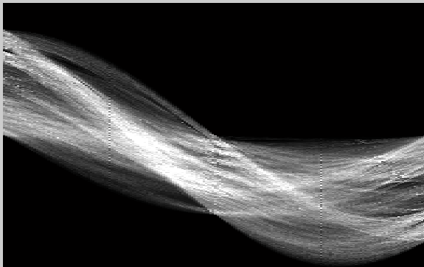
2. Canny → Hough votes

Slide 52
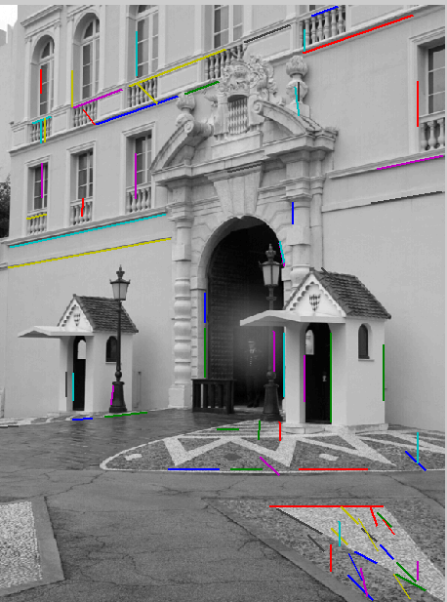
3. Hough votes → Edges
Find peaks and post-process

Slide 53
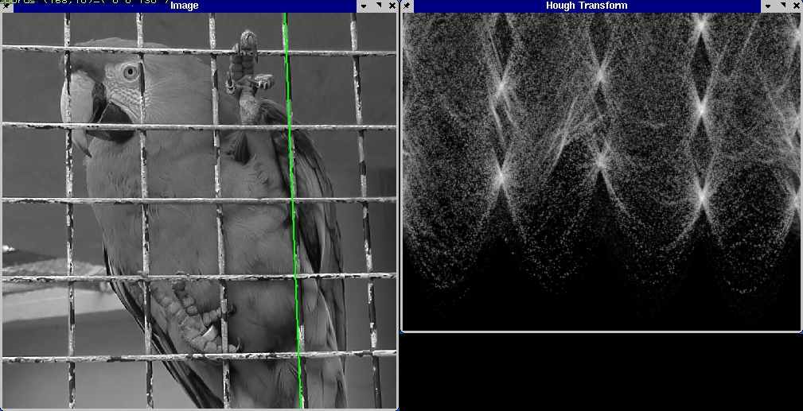
Hough transform example
http://ostatic.com/files/images/ss_hough.jpg

Slide 54
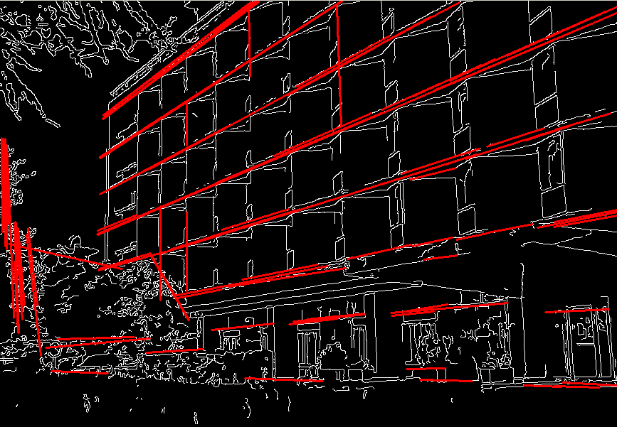

Hough transform examples
OpenCV: probabilistic hough transform

Slide 55
Finding circles using Hough transform
Fixed r
Variable r

Slide 56
Finding straight lines
Another solution: get connected components of pixels and check for straightness

Slide 57
Finding line segments using connected components
Compute canny edges
Compute: gx, gy (DoG in x,y directions)
Compute: theta = atan(gy / gx)
Assign each edge to one of 8 directions
For each direction d, get edgelets:
find connected components for edge pixels with directions in {d-1, d, d+1}
Compute straightness and theta of edgelets using eig of x,y 2nd moment matrix of their points
Threshold on straightness, store segment
Larger eigenvector

Slide 58
1. Image → Canny

Slide 59
2. Canny lines → … →straight edges

Slide 60
Comparison
Hough Transform Method
Connected Components Method

Slide 61
Things to remember
Canny edge detector = smooth → derivative → thin → threshold → link
Generalized Hough transform = points vote for shape parameters
Straight line detector = canny + gradient orientations → orientation binning → linking → check for straightness

Slide 62
Next classes
Fitting and Registration
Clustering
EM (mixture models)

Slide 63
Questions

